Slide 1
Supervised Learning and Text Classification
Kyunghyun Cho
New York University
Courant Institute (Computer Science) and Center for Data Science
Facebook AI Research

Slide 2
Supervised Learning – Overview
Provided:
a set of N input-output “training” examples
A per-example loss function⭑
Evaluation sets*: validation and test examples
What we must decide:
Hypothesis sets
Each set consists of all compatible models
Optimization algorithm
⭑ Often it is necessary to design a loss function.
* Often these sets are created by holding out subsets of training examples.

Slide 3
Supervised Learning – Overview
Given:
and
Optimization algorithm
Supervised learning finds an appropriate algorithm/model automatically
For each hypothesis set , find the best model:* using the optimization algorithm.

Slide 4
Supervised Learning – Overview
Given:
and
Optimization algorithm
Supervised learning finds an appropriate algorithm/model automatically
[Training] For each hypothesis set , find the best model:* using the optimization algorithm and the training set.

Slide 5
Supervised Learning – Overview
Given:
and
Optimization algorithm
Supervised learning finds an appropriate algorithm/model automatically
[Model Selection]* Among the trained models, select the best one using the validation set loss.
* If you’re familiar with deep learning, “hyperparameter optimization” may be a more familiar term for you.

Slide 6
Supervised Learning – Overview
Given:
and
Optimization algorithm
Supervised learning finds an appropriate algorithm/model automatically
[Reporting] Report how well the best model would work using the test set loss.
* If you’re familiar with deep learning, “hyperparameter optimization” may be a more familiar term for you.

Slide 7
Supervised Learning
Three points to consider both in research and in practice
How do we decide/design a hypothesis set?
How do we decide a loss function?
How do we optimize the loss function?

Slide 8
Hypothesis set – Neural Networks
What kind of machine learning approach will we consider?
Classification:
Support vector machines, Naïve Bayes classifier, logistic regression, …?
Regression:
Support vector regression, Linear regression, Gaussian process, …?
How are the hyperparameters sets?
Support vector machines: regularization coefficient
Gaussian process: kernel function

Slide 9
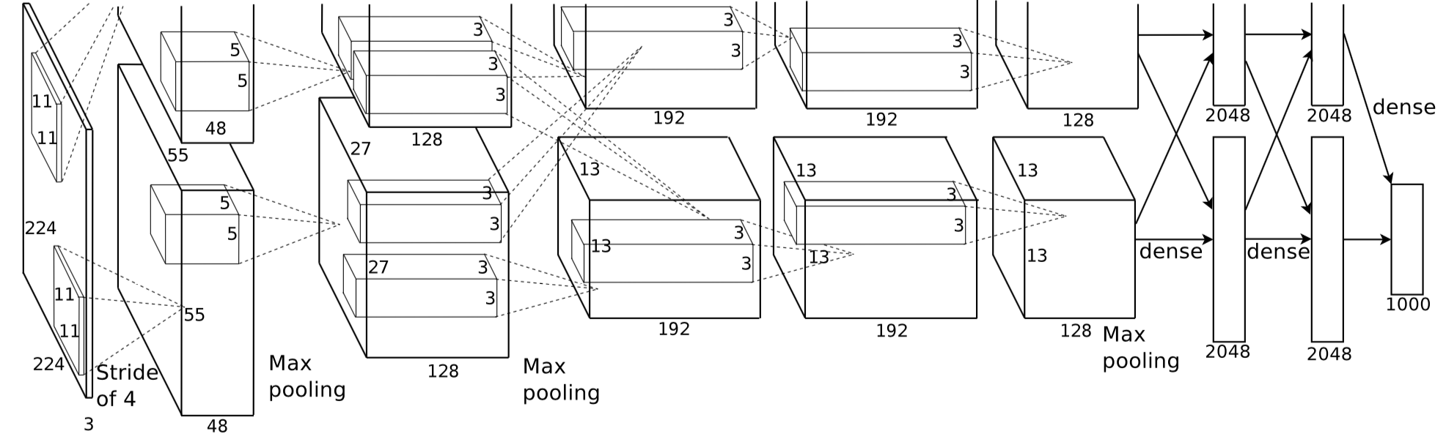
Hypothesis set – Neural Networks
In the case of deep learning/artificial neural networks,
The architecture of a network defines a set
Each model in the set is characterized by its parameters
Weights and bias vectors define one model in the hypothesis set.
There are infinitely many models in a hypothesis set.
We use optimization to find “a” good model from the hypothesis set.
vs.

Slide 10
Network Architectures
What is a neural network? – An (arbitrary) directed acyclic graph (DAG)
Solid Circles : parameters (to be estimated or found)
Dashed Circles : vector inputs/outputs (given as a training example)
Squares : compute nodes (functions, often continuous/differentiable)

Slide 11
Network Architectures
What is a neural network? – An (arbitrary) directed acyclic graph (DAG)
Logistic regression
3rd-order polynomial function

Slide 12
Inference – Forward Computation
What is a neural network? – An (arbitrary) directed acyclic graph (DAG)
Forward computation: how you “use” a trained neural network.
Topological sweep (breadth-first)
Logistic regression

Slide 13
DAG ↔ Hypothesis Set
What is a neural network? – An (arbitrary) directed acyclic graph (DAG)
Implication in practice
Naturally supports high-level abstraction
Object-oriented paradigm fits well.*
Base classes: variable (input/output) node, operation node
Define the internal various types of variables and operations by inheritance
Maximal code reusability
See the success of PyTorch, TensorFlow, DyNet, Theano, …
You define a hypothesis set by designing a directed acyclic graph.
The hypothesis space is then a set of all possible parameter settings.
* Functional programming as well ☺

Slide 14
Supervised Learning
Three points to consider both in research and in practice
How do we decide/design a hypothesis set?
How do we decide a loss function?
How do we optimize the loss function?

Slide 15
Loss Functions
Per-example loss function
Computes how good a model is doing on a given example:
So many loss functions…
Classification: hinge loss, log-loss, …
Regression: mean squared error, mean absolute error, robust loss, …
In this lecture, we stick to distribution-based loss functions.

Slide 16
Probability in 5 minutes – (1)
An “event set” contains all possible events:
Discrete: when there are a finite number of events
Continuous: when there are infinitely many events
A “random variable” could take any one of these events:
A probability of an event:
How likely would the i-th event happen?
How often has the i-th event occur relative to the other events?
Properties
Non-negative:
Unit volume:

Slide 17
Probability in 5 minutes – (2)
Multiple random variables: consider two here -
A joint probability
How likely would and happen together?
A conditional probability
Given , how likely would happen?
The chance of both happening together divided by that of happening regardless of whether happened:
Probability function returns a probability of

Slide 18
Probability in 5 minutes – (3)
Multiple random variables: consider two here -
A joint probability
How likely would and happen together?
A marginal probability
Regardless of what happens to , how likely is ?

Slide 19
A Neural network computes a conditional distribution
Supervised learning: what is y given x?
In other words, how probable is a certain value y’ of y given x?
What kind of distributions?
Binary classification: Bernoulli distribution
Multiclass classification: Categorical distribution
Linear regression: Gaussian distribution
Multimodal linear regression: Mixture of Gaussians

Slide 20
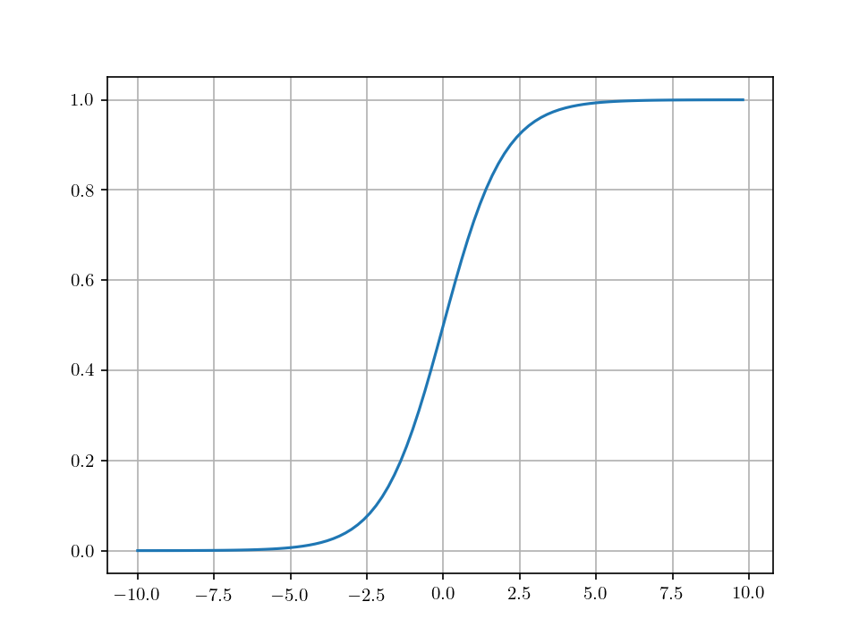
Important distributions – Bernoulli
How probable is a certain value y’ of y given x?
Binary classification: Bernoulli distribution
Probability: , where
Fully characterized by .
A neural network then should turn the input into using a sigmoid function :
An arbitrary
sub-graph

Slide 21
Important distributions – Categorical
How probable is a certain value y’ of y given x?
Multi-class classification: Categorical distribution
Probability: , where
Fully characterized by .
A neural network then should turn the input into a vector using a softmax function: .
An arbitrary
sub-graph

Slide 22
Important distributions – Gaussian
How probable is a certain value y’ of y given x?
Regression: Gaussian distribution with an identity covariance
Probability:
Fully characterized by .
A neural network then should turn the input into a vector .
Can be done trivially by affine transformation.

Slide 23
Loss Function – negative log-probability
Once a neural network outputs a conditional distribution , a natural way to define a loss function arises.
Make sure training data is maximally likely:
Equiv. to making sure each and every training example is maximally likely.
Why log? – many reasons… but out of the lecture’s scope.
Equivalently, we want to minimize the negative log-probability.
A loss function is the sum of negative log-probabilities of correct answers.

Slide 24
Loss Function – negative log-probability
Once a neural network outputs a conditional distribution , a natural way to define a loss function arises.
Practical implications
An OP node: negative log-probability (e.g., NLLLoss in PyTorch)
Inputs: the conditional distribution and the correct output
Output: the negative log-probability (a scalar)

Slide 25
Loss Function – negative log-probability
Once a neural network outputs a conditional distribution , a natural way to define a loss function arises.
Logistic regression
Computes a Bernoulli distribution
Computes a negative log-probability
All in one directed acyclic graph
Forward computation
Computes the conditional distribution, and
Computes the per-example loss
NLLLoss

Slide 26
Supervised Learning
Three points to consider both in research and in practice
How do we decide/design a hypothesis set?
How do we decide a loss function?
How do we optimize the loss function?

Slide 27
Loss Minimization
What we now know
How to build a neural network with an arbitrary architecture.
How to define a per-example loss as a negative log-probability.
Define a single directed acyclic graph containing both.
What Francis Bach is teaching you
Learning as optimization
Optimization algorithms
What we now need to know
How to compute the gradient
Use the gradient with an optimization algorithm

Slide 28
Local, iterative optimization
An arbitrary function
Given the current value , how should I move to minimize ?
Random guided search
Stochastically perturb : , where
Test each perturbed point
Find the best perturbed point
Repeat this until no improvement could be made.
Applicable to any arbitrary loss function and neural network.
Inefficient in the high-dimensional parameter space: large .

Slide 29
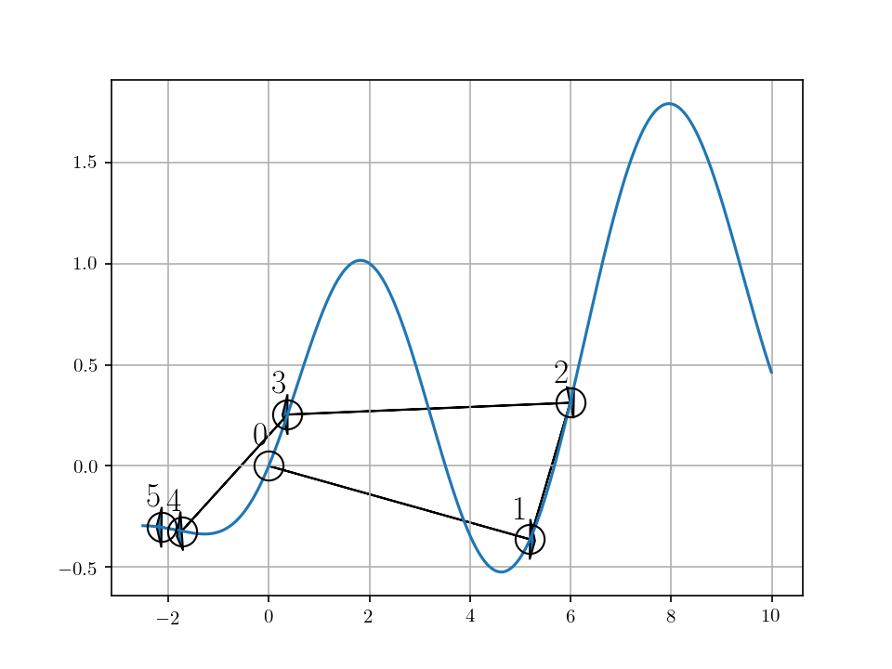
Local, iterative optimization
An arbitrary function
Given the current value , how should I move to minimize ?
Random guided search
Applicable to any arbitrary loss function and neural network.
Inefficient in the high-dimensional parameter space

Slide 30
Gradient-based optimization
A continuous, differentiable* function
Given the current value , how should I move to minimize ?
Gradient descent
The negative gradient of the function:
This is only valid in a local neighbourhood of : take a very small step!
Efficient and effective even in the high dimensional space.
Can be improved with the second-order information (Hessian and/or FIM)
* Almost everywhere, but not necessarily everywhere

Slide 31
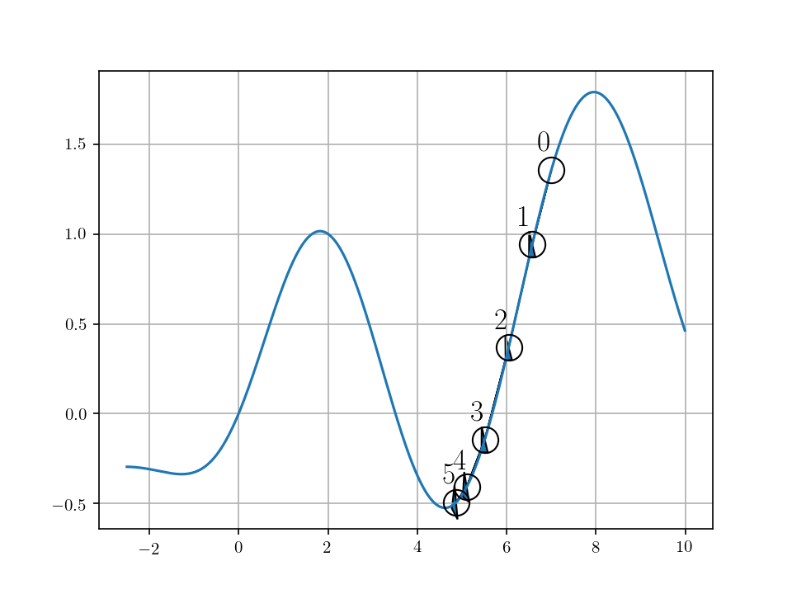
Gradient-based optimization
A continuous, differentiable function
Given the current value , how should I move to minimize ?
Gradient descent
Efficient and effective even in the high dimensional space.
Learning rate must be carefully selected and annealed over time.

Slide 32
Backward Computation – Backpropagation
How do we compute the gradient of the loss function?
Manual derivation
Relatively doable when the DAG is small and simple.
When the DAG is larger and complicated, too much hassle.
Automatic differentiation (autograd)
Use the chain rule of derivatives
The DAG is nothing but a composition of (mostly) differentiable functions.
Automatically apply the chain rule of derivatives.

Slide 33
Backward Computation – Backpropagation
Automatic differentiation (autograd)
Implement the Jacobian-vector product of each OP node:
Can be implemented efficiently without explicitly computing the Jacobian.
The same implementation can be reused every time the OP node is called.

Slide 34
Backward Computation – Backpropagation
Automatic differentiation (autograd)
Reverse-sweep the DAG starting from the loss function node.
Iteratively multiplies the Jacobian of each OP node until the leaf nodes of the parameters.
(Often) as expensive as forward computation with a constant overhead: O(N)
NLLLoss

Slide 35
Backward Computation – Backpropagation
Practical Implications – Automatic differentiation (autograd)
Unless a complete new OP is introduced, no need to manually derive the gradient
Nice de-coupling of specification (front-end) and implementation (back-end)
[Front-end] Design a neural network by creating a DAG.
[Back-end] The DAG is “compiled” into an efficient code for a target compute device.
GPU
GPU
CPU
Compilation
CPU
CPU
CPU
Compute Backend
DAG

Slide 36
Gradient-based Optimization
Backpropagation gives us the gradient of the loss function w.r.t.
Readily used by an off-the-shelf gradient-based optimizer
Stochastic gradient descent
Approximate the full loss function (the sum of per-examples losses) using only a small random subset of training examples:

Slide 37
Stochastic Gradient Descent
Stochastic gradient descent
Approximate the full loss function (the sum of per-examples losses) using only a small random subset of training examples:
Unbiased estimate of the full gradient.*
Learning rate must be annealed appropriately.
Extremely efficient de facto standard practice.
* Under certain conditions

Slide 38
Stochastic Gradient Descent
Stochastic gradient descent in practice
Grab a random subset of M training examples*
Compute the minibatch gradient
Update the parameters
Repeat until the validation loss stops improving.⭑
* Sample without replacement until the training set is exhausted (one epoch).
⭑ This is called early-stopping which prevents the neural network from overfitting to training examples.

Slide 39
Stochastic Gradient Descent – Early Stopping
Stochastic gradient descent in practice
Grab a random subset of M training examples
Compute the minibatch gradient
Update the parameters
Repeat until the validation loss stops improving.
An efficient way to prevent overfitting
Overfitting: the training loss is low, but the validation loss is not.
The most serious problem in statistical machine learning.
Early-stop based on the validation loss

Slide 40
Stochastic Gradient Descent – Early Stopping
An efficient way to prevent overfitting
Overfitting: the training loss is low, but the validation loss is not.
The most serious problem in statistical machine learning.
Early-stop based on the validation loss
Hypothesis set

Slide 41
Stochastic Gradient Descent – Adaptive Learning Rate
Stochastic gradient descent in practice
Grab a random subset of M training examples
Compute the minibatch gradient
Update the per-parameter learning rate
Update the parameters
Repeat until the validation loss stops improving.
Adaptive learning rate: Adam [Kingma&Ba, 2015], Adadelta [Zeiler, 2015], and many more…
Approximately re-scale parameters to improve the conditioning of the Hessian.

Slide 42
Supervised Learning with Neural Networks
How do we decide/design a hypothesis set?
Design a network architecture as a directed acyclic graph
How do we decide a loss function?
Frame the problem as a conditional distribution modelling
The per-example loss function is a negative log-probability of a correct answer
How do we optimize the loss function?
Automatic backpropagation: no manual gradient derivation
Stochastic gradient descent with early stopping [and adaptive learning rate]

Slide 43
Any Questions?

Slide 44
Text Classification
Input: a natural language sentence/paragraph
Output: a category to which the input text belongs
There are a fixed number of categories
Examples
Sentiment analysis: is this review positive or negative?
Text categorization: which category does this blog post belong to?
Intent classification: is this a question about a Chinese restaurant?

Slide 45
How to represent a sentence
A sentence is a variable-length sequence of tokens:
Each token could be any one from a vocabulary:
Examples
(마드리드에서, 강의, 중, 입니다, .)
Vocabulary: All unique, space-separated tokens in Korean
(마드리드, 에서, 강의, 중, 입니다, .)
Vocabulary: All uniqued, segmented tokens in Korean
(마, 드, 리, 드, 에, 서, [], 강, 의, [], 중, [], 입, 니, 다, .)
Vocabulary: All Korean syllables
And many more possibilities…

Slide 46
How to represent a sentence
A sentence is a variable-length sequence of tokens:
Each token could be any one from a vocabulary:
Once the vocabulary is fixed and encoding is done, a sentence or text is just a sequence of “integer indices”.
Examples:
(마드리드, 에서, 강의, 중, 입니다, .)
(5241, 20, 288, 12, 19, 5)
Index | Token
5 | .
12 | 중
19 | 입니다
20 | 에서
… | …
288 | 강의
827 | 재단
… | …

Slide 47
How to represent a token
A token is an integer “index”.
How do should we represent a token so that it reflects its “meaning”?
First, we assume nothing is known: use an one-hot encoding.
: the size of vocabulary
Only one of the elements is 1:
Every token is equally distant away from all the others.

Slide 48
How to represent a token
How do should we represent a token so that it reflects its “meaning”?
First, we assume nothing is known: use an one-hot encoding.
Second, the neural network capture the token’s meaning as a vector.
This is done by a simple matrix multiplication: where is the token’s index in the vocabulary.
Table Lookup

Slide 49
How to represent a sentence – CBoW
After the table-lookup operation,* the input sentence is a sequence of continuous, high-dimensional vectors:
The sentence length differs from one sentence to another.
The classifier needs to eventually compress it into a single vector.
A fixed-size vector representation of the input
An arbitrary
sub-graph
* The table-lookup operation would be one node in the DAG.

Slide 50
How to represent a sentence – CBoW
Continuous bag-of-words
Ignore the order of the tokens:
Simply average the token vectors:
Averaging is a differentiable operator.
Just one operator node in the DAG.
Generalizable to bag-of-n-grams
N-gram: a phrase of N tokens
Extremely effective in text classification [Iyyer et al., 2016; Cho, 2017; and many more]
For instance, if there are many positive words, the review is likely positive.
In practice, use FastText [Bojanowski et al., 2017]

Slide 51
How to represent a sentence – CBoW
Continuous bag-of-words based multi-class text classifier
With this DAG, you use automatic backpropagation and stochastic gradient descent to train the classifier.
Table Lookup
Table Lookup
Softmax
An arbitrary
sub-graph
Average
Table Lookup

Slide 52
How to represent a sentence – RN
Relation Network [Santoro et al., 2017]: Skip Bigrams
Consider all possible pairs of tokens:
Combine two token vectors with a neural network for each pair
is a element-wise nonlinear function, such as tanh or ReLU ( )
One subgraph in the DAG.
Table Lookup
MatMul
MatMul
Table Lookup
MatMul

Slide 53
How to represent a sentence – RN
Relation Network: Skip Bigrams
Considers all possible pairs of tokens:
Considers the “relation”ship between each pair of words
Averages all these relationship vectors
Could be generalized to triplets and so on at the expense of computational efficient.
Table Lookup
MatMul
MatMul
Table Lookup
MatMul

Slide 54
How to represent a sentence – RN
Relation Network: Skip Bigrams
Considers all possible pairs of tokens:
Considers the pair-wise “relation”ship
Averages all these relationship vectors
RN
RN
RN
Softmax
An arbitrary
sub-graph
RN
RN
RN
Average
RN
RN
RN

Slide 55
How to represent a sentence – CNN
Convolutional Networks [Kim, 2014; Kalchbrenner et al., 2015]
Captures k-grams hierarchically
One 1-D convolutional layer: considers all k-grams , resulting in .
Stack more than one convolutional layers: progressively-growing window
Fits our intuition of how sentence is understood: tokens→multi-word expressions→phrases→sentence

Slide 56
How to represent a sentence – CNN
Convolutional Networks [Kim, 2014; Kalchbrenner et al., 2015]
Captures k-grams hierarchically
Stack more than one convolutional layers: progressively-growing window
tokens→multi-word expressions→phrases→sentence
In practice, just another operation node in a DAG:
Extremely efficient implementations are available in all of the major frameworks.
Recent advances
Multi-width convolutional layers [Kim, 2014; Lee et al., 2017]
Dilated convolutional layers [Kalchbrenner et al., 2016]
Gated convolutional layers [Gehring et al., 2017]

Slide 57
How to represent a sentence – Self-Attention
Can we combine and generalize the relation network and the CNN?
Relation Network:
Each token’s representation is computed against all the other tokens
CNN:
Each token’s representation is computed against neighbouring tokens
RN considers the entire sentence vs. CNN focuses on the local context.

Slide 58
How to represent a sentence – Self-Attention
Can we combine and generalize the relation network and the CNN?
CNN as a weighted relation network:
Original:
Weighted: where .
Can we compute those weights instead of fixing them to 0 or 1?

Slide 59
How to represent a sentence – Self-Attention
Can we compute those weights instead of fixing them to 0 or 1?
That is, compute the weight of each pair
The weighting function could be yet another neural network
Just another subgraph in a DAG: easy to use!
Perhaps we want to normalize them so that the weights sum to one
[Bahdanau et al., 2015; Vaswani et al., 2017; Parikh et al., 2016]

Slide 60
How to represent a sentence – Self-Attention
Self-Attention: a generalization of CNN and RN.
Able to capture long-range dependencies within a single layer.
Able to ignore irrelevant long-range dependencies.
Weighting
Function
Summation
RN

Slide 61
How to represent a sentence – Self-Attention
Self-Attention: a generalization of CNN and RN.
Able to capture long-range dependencies within a single layer.
Able to ignore irrelevant long-range dependencies.
Further generalization via multi-head and multi-hop attention
Weighting
Function
Summation
RN

Slide 62
How to represent a sentence – RNN
Weaknesses of self-attention
Quadratic computational complexity
Some operations cannot be done easily: e.g., counting, …
Online compression of a sequence
, where .
Memory allows it to be Turing complete.*
* Under some extreme assumptions…

Slide 63
How to represent a sentence – RNN
Recurrent neural network: online compression of a sequence
, where .
Bidirectional RNN to account for both sides.
Inherently sequential processing
Less desirable for modern, parallelized, distributed computing infrastructure.
LSTM [Hochreiter&Schmidhuber, 1999] and GRU [Cho et al., 2014] have become de facto standard
All standard frameworks implement them.
Efficient GPU kernels are available.
Concat
RNN
RNN
RNN
RNN
RNN
RNN

Slide 64
How to represent a sentence
We have learned five ways to extract a sentence representation:
In all but CBoW, we end up with a set of vector representations.
These approaches could be “stacked” in an arbitrary way to improve performance.
Chen, Firat, Bapna et al. [2018] combine self-attention and RNN to build the state-of-the-art machine translation system.
Lee et al. [2017] stack RNN on top of CNN to build an efficient fully character-level neural translation system.
Because all of these are differentiable, the same mechanism (backprop+SGD) works as it is for any other machine learning model.
These vectors are often averaged/max-pooled for classification.

Slide 65
So far, we have learned…
Token representation
How do we represent a discrete token in a neural network?
Training this neural network leads to so-called continuous word embedding.
Sentence representation
How do we extract useful representation from a sentence?
We learned five different ways to do so: CBoW, RN, CNN, Self-Attention, RNN

Slide 66
In the next lecture,
Language modelling
A bit more on recurrent networks
Exploding and vanishing gradient
RNN vs. GRU/LSTM

